Slide 1
Ad Content Authoring
delivering exceptional user experiences for business users and members alike

Slide 2
stands for Global Digital Experience.
Our mission is to deliver outstanding digital experiences, for current and future members.
d
g
x

Slide 3
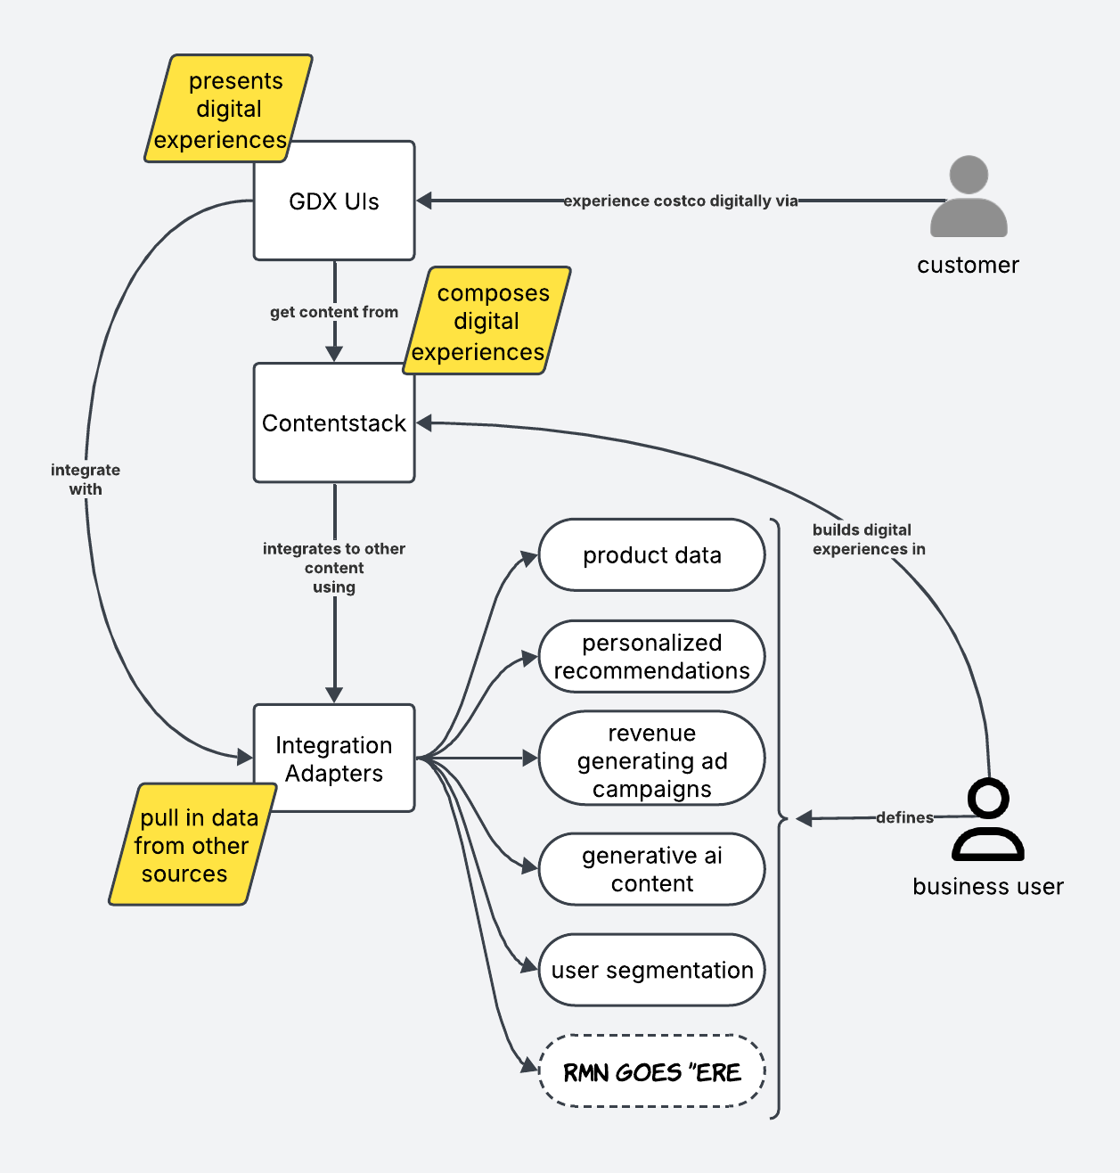
A composable content management architecture
GDX provides capabilities to build digital experiences, centered around our CMS, Contentstack.
It is a central hub for digital experience management.
“Author Once, Display Everywhere, All at Once”
Allows rapid integration with other data sources
Allows rapid delivery of new experiences

Slide 4
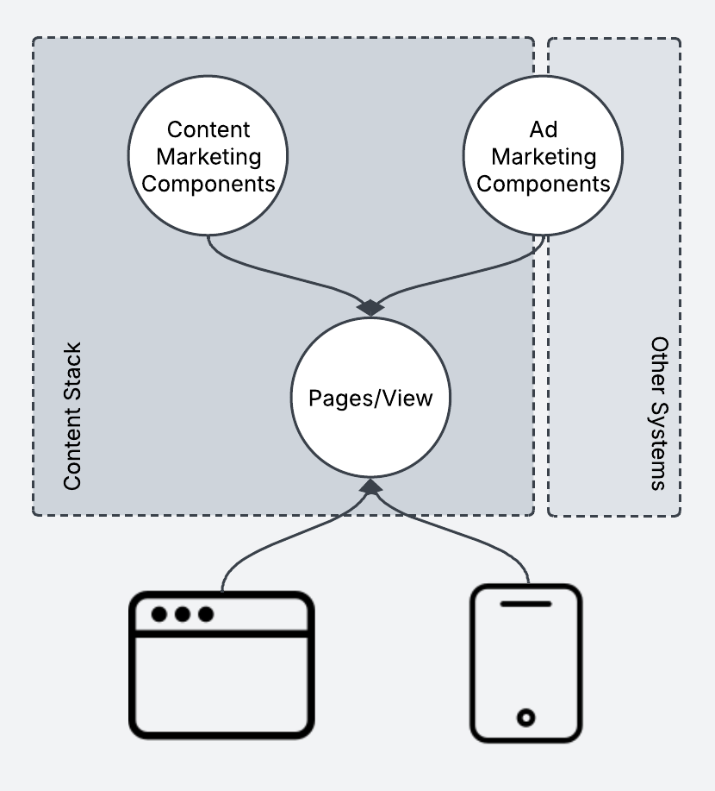
All Ads are Content, but not all Content is an Ad.

Slide 5
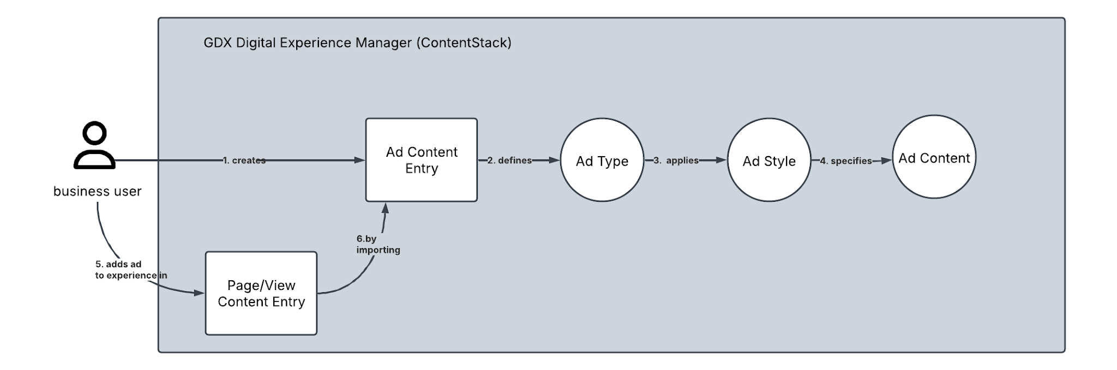
Generalized Ad Workflow
Ads are created as reusable content entries within our CMS, and then applied to pages or view
We give our users the power to select an ad type, which defines its behaviour, and the options available in ad setup.
We allow our users to pick various ad styles to control the display of their ads
We provide capabilities to our users to populate ads with content from within the CMS, or from external sources

Slide 6
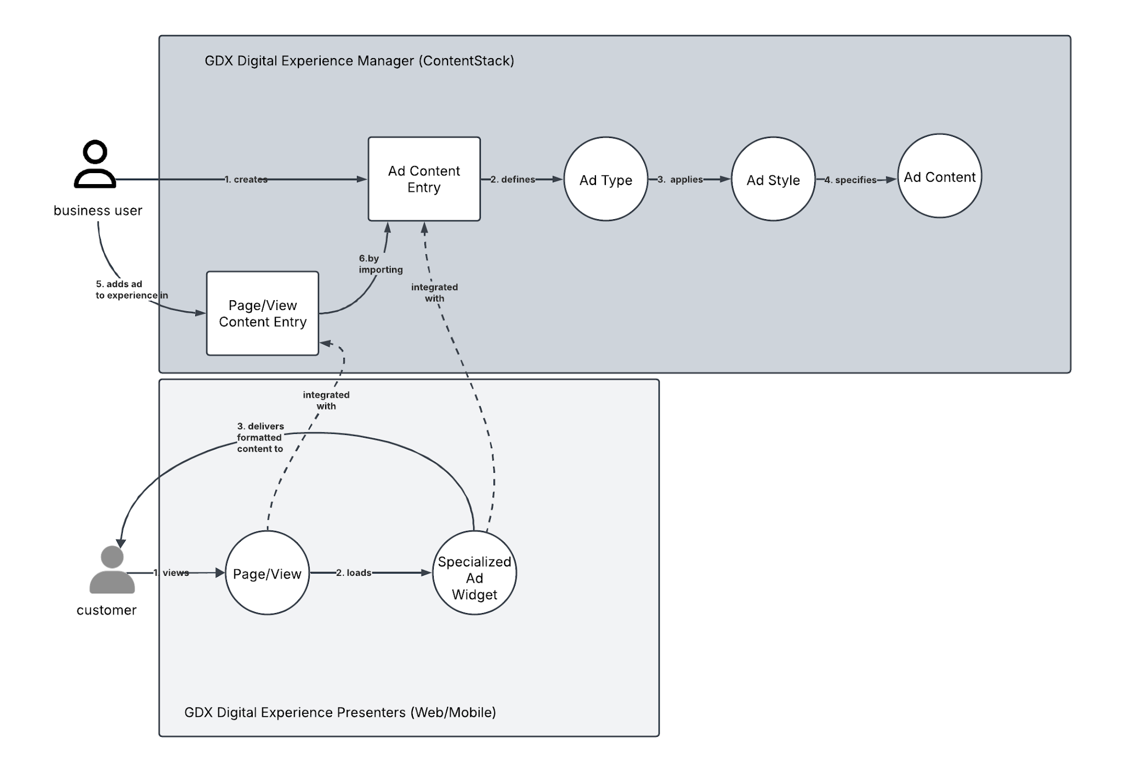
Internally Curated Ads Architecture
Recommended for use if you feel like you can meet your own targeting without non-content data.
Examples:
Campaign Sliders
Feature Highlight Cards
Bullet Detail Accordion
Inventory Aware Carousels
and more...

Slide 7
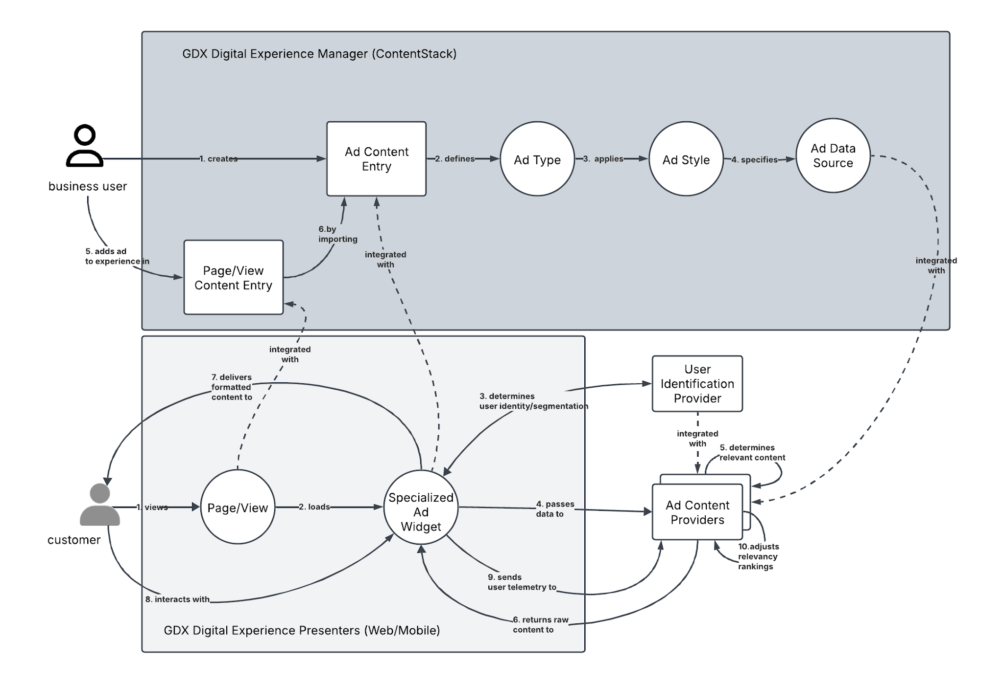
Externally Managed Ads Architecture
Recommended for use when you need non-content data to meet your targeting needs
User Segmentation
Individual User Personalization
Revenue Generating placement
and more...

Slide 8
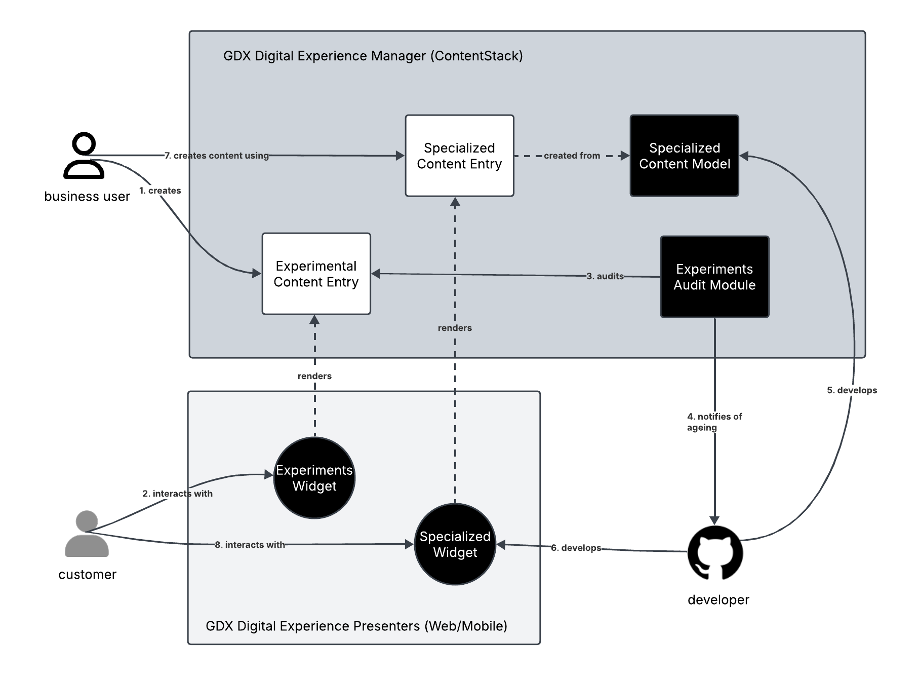
Solving for the Speed of Business
Our Digital Experience Management Platform:
Separates content from presentation in order to keep content reusable and channel agnostic.
Specialized Widgets deliver an optimal content experience for each delivery channel
the Experimental Content Entry provides Business user with the autonomy to experiment with new designs
A path exists to formalize successful experiments
Experiments support full creative reign, with limited guardrails and limited integration capabilities as standard.

